Slide 1

Troll Hunters Detecting abrasive online content
Indranil Pal
Yasser Parambathkandy
Deepak Rajan

Slide 2
Cover page

Slide 3

Agenda and Objective
Agenda
Introduction
How are we different
Objectives
Project timeline
About the Data
Architecture
Evaluation and Results
Conclusions
References
Demo
Objective
Better understand how to detect and identify content that is not made in good faith
Don’t be this guy

Slide 4
Objective
Objective
Better understand how to detect and identify content that is not made in good faith
Don’t be this guy

Slide 5

The Problem
Trolls: People who intentionally cause annoyance, grief, or frustration online.
Influencing emotion or perception
Amusement/Schadenfreude
Why is this a problem?
Weakens online communities
Allows for misinformation to develop
Negative press could weaken a company/platform
Companies might be liable for user content and open themselves to criminal penalties or civil litigation

Slide 6


The Data: Source
The data is accessed via Kaggle but ultimately is from Quora
Quora is an online social forum where users ask, and answer, questions posted by other users
Kaggle competition: develop models to better classify sincere vs insincere questions
Insincere questions are those that are considered purposefully abrasive, toxic, divisive, misleading, inflammatory and/or contain absurd assumptions.

Slide 7
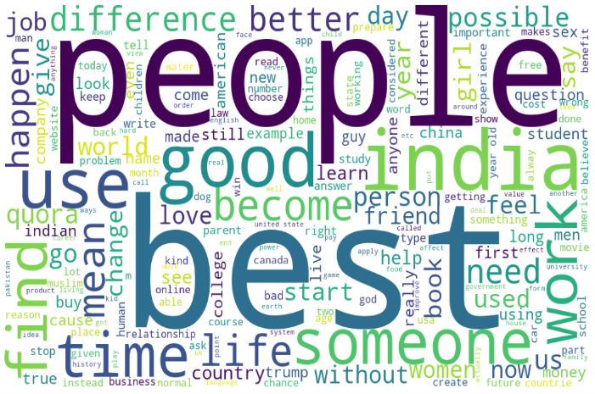
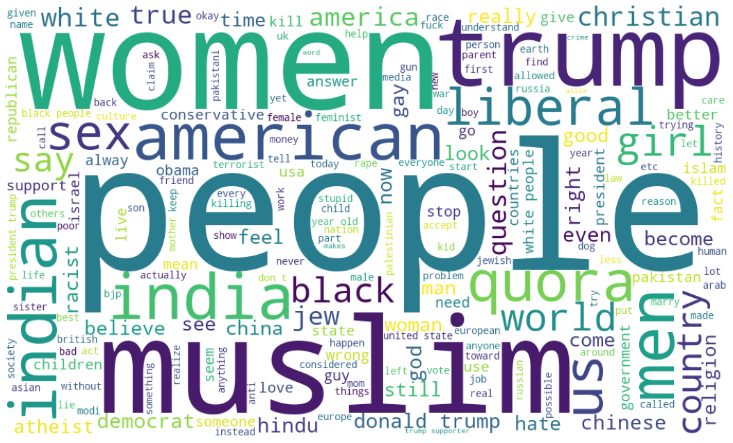
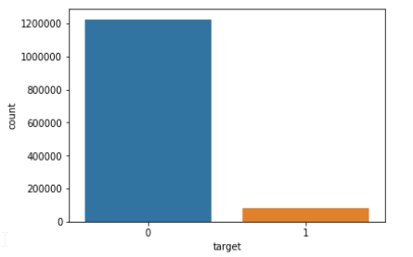
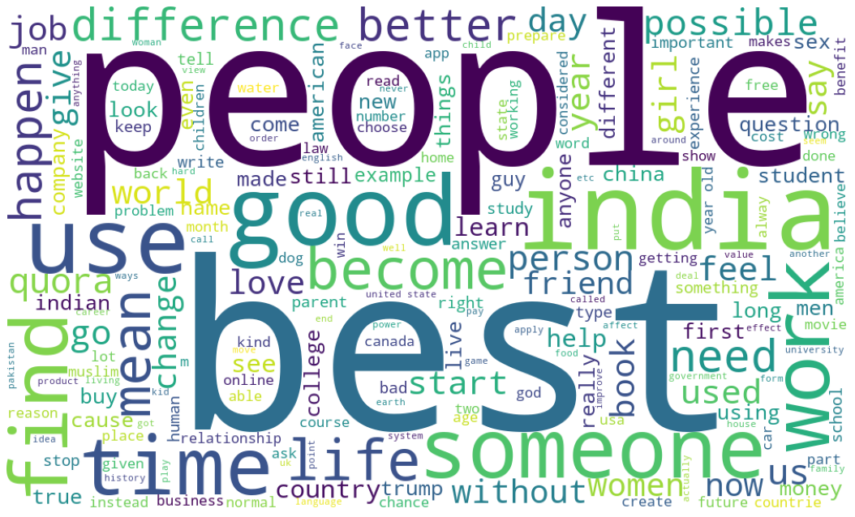
The Data: Explored
The data contain more than 1.3 million questions
Data is imbalanced
Sincere questions outnumber insincere questions considerably
Inherently subjective
Dataset has some incorrect classification (noise)
Insincere Word Cloud
Target | Meaning | Count | Proportion
0 | Sincere | 1,225,312 | 94%
1 | Insincere | 80,810 | 6%
Totals |  | 1,306,122 | 100%
Sincere Word Cloud

Slide 8
The Data: Sample Questions

Slide 9
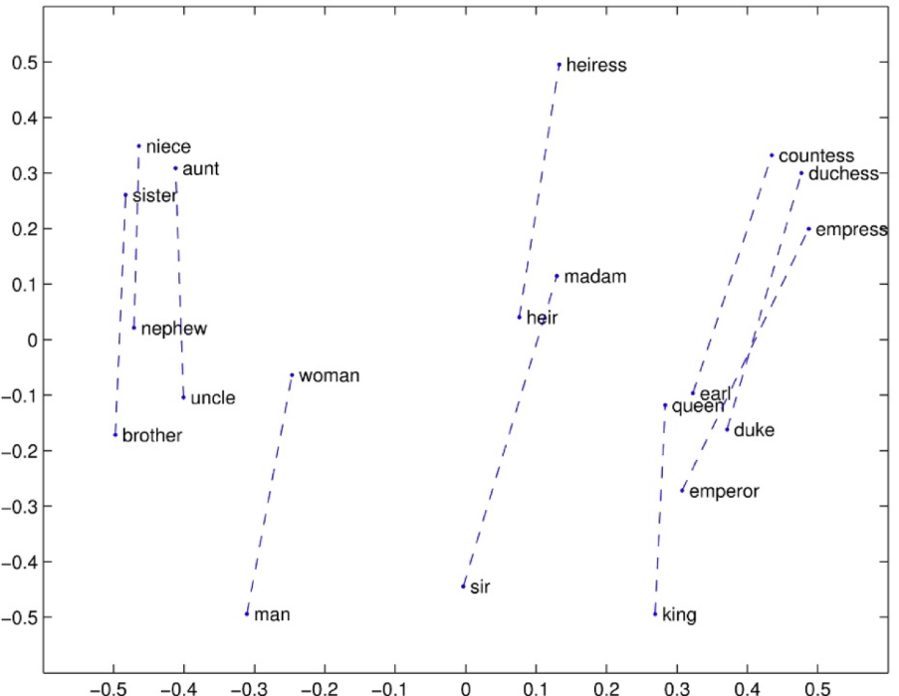
Existing Research
Typical natural language involves conversion of text to high dimensional vector.
Machines understand numbers better than text.
Plot the numbers and find distance for similarity
Existing research to do text-to-vector conversion uses Word embeddings like word2vec, TF-IDF, and pre-trained model like GloVe.
Most of Kaggle competition notebook uses GloVe Embeddings
The primary disadvantage with word embedding is the loss of context
The question “Is the duck swimming?” and “Should I duck when a cow attacks?” should be treated as contextually two different questions.

Slide 10
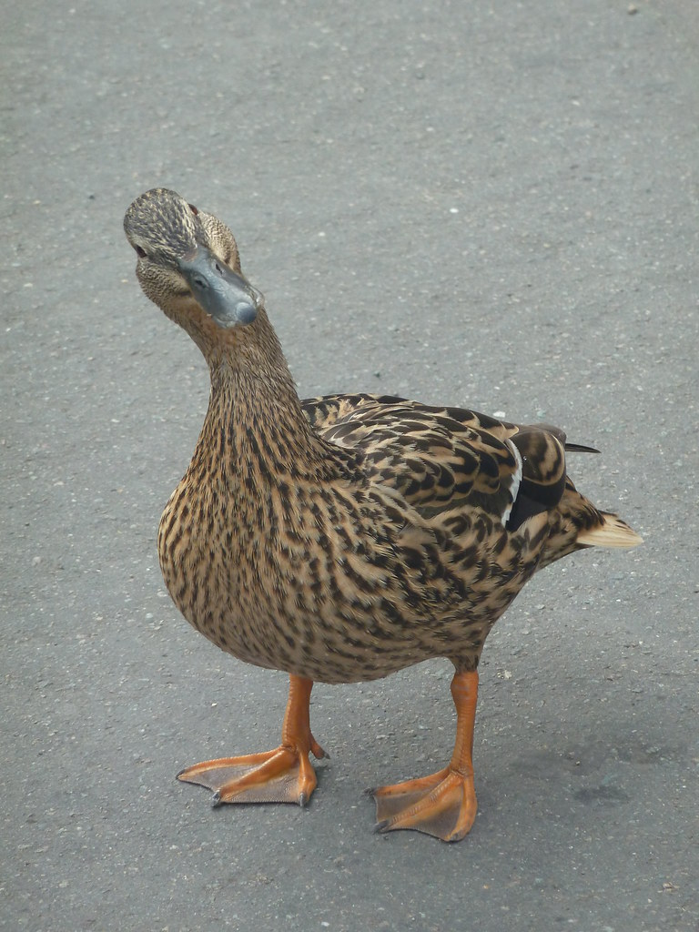
Approach Rationale
The Kaggle competition required the use of word embeddings
Our research focused on using sentence embeddings
Language is ambiguous
Hypothesis: Sentence embeddings allow for more context and more accurate classification of questions
“This is a duck”
VS.
“Is this a duck?”
Duck can be:
an animal
an act of dodging or lowering
used in phrases such as ‘lame duck’

Slide 11
How are we different?
Sentence Encoder
Sentence embedding is relatively a new entry in the world of embeddings.
Google research created a pre-trained model from 3 billion documents in 2018
Universal Sentence encoder
Publicly available in Tensorflow-hub.
Project Scope/contribution
Develop models using Universal Sentence encoder and GloVe word embeddings
Supervised
Compare performance of models and evaluate results

Slide 12
Architecture

Slide 13
Evaluation and Results
Scores from different models and embedding
Inference
Sentence embedding has superior F1 score in Logistic Regression compared to GloVe(Word) embedding
Sentence and word embedding has similar F1 score
Word embedding required lot of preprocessing
Kaggle competition top results ranged between 67%-72% involving complex and stacked models
High scores were achieved with a simple sentence embedding model with minimal tuning
Error analysis
Incorrect labeling and profane words in sincere questions

Slide 14
Conclusion and Future Work
We have used F1 Score as metric between the predicted and the observed targets as the dataset is highly imbalanced. The F1 score obtained is as good as the top scores in the Kaggle competition.
Four models were developed using the embeddings and the results showed improved or similar performance for models based on universal sentence encoder embeddings. Specifically, Sentence embedding displays higher F1 score for insincere class using logistic regression, which is a key observation from the outcome of our work and meets the primary objective of the project
Sentence and word embedding displays similar F1 score, but word embedding required a lot of pre-processing like word tokenizer, stop words etc for each of the words to get to the F1 score of sentence embedding. (not completely true)
As part of future work, we would like to evaluate the performance of model against train and test dataset so understand any overfitting.
In future, we would also like to evaluate other techniques like BERT to understand if it provides better F1 score.
Tuning of the model parameters like epoch size, batch size, choice of activation function, and learning rate could be tuned to improve the accuracy.
Apply the model and techniques to a different dataset like longer statements and declarative statements other than questions

Slide 15
Demo

